Slide 1

Al Nafi
Let’s educate the world to make it a better place.
As Education Benefits All.
Education Benefits All.
© Al-Nafi. All Rights Reserved.

Slide 2
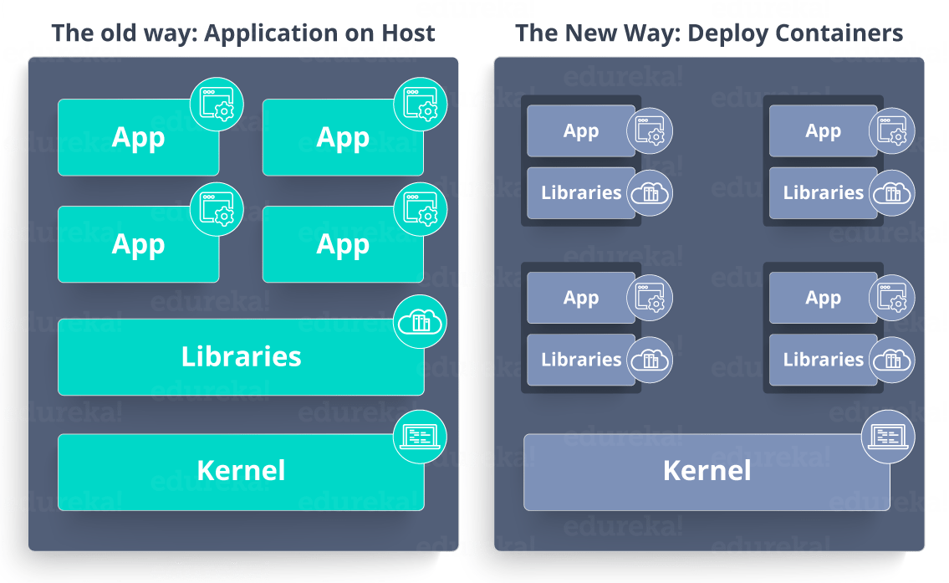

Slide 3
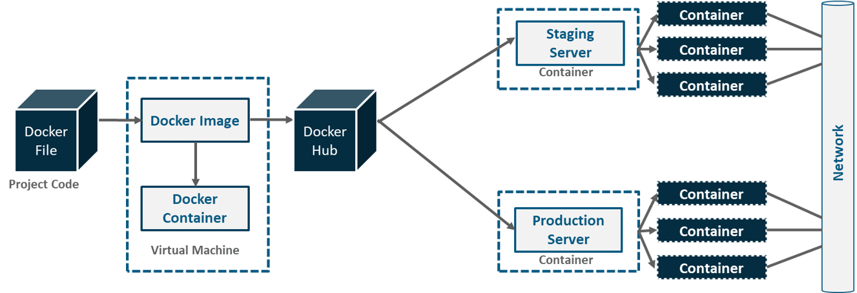

Slide 4
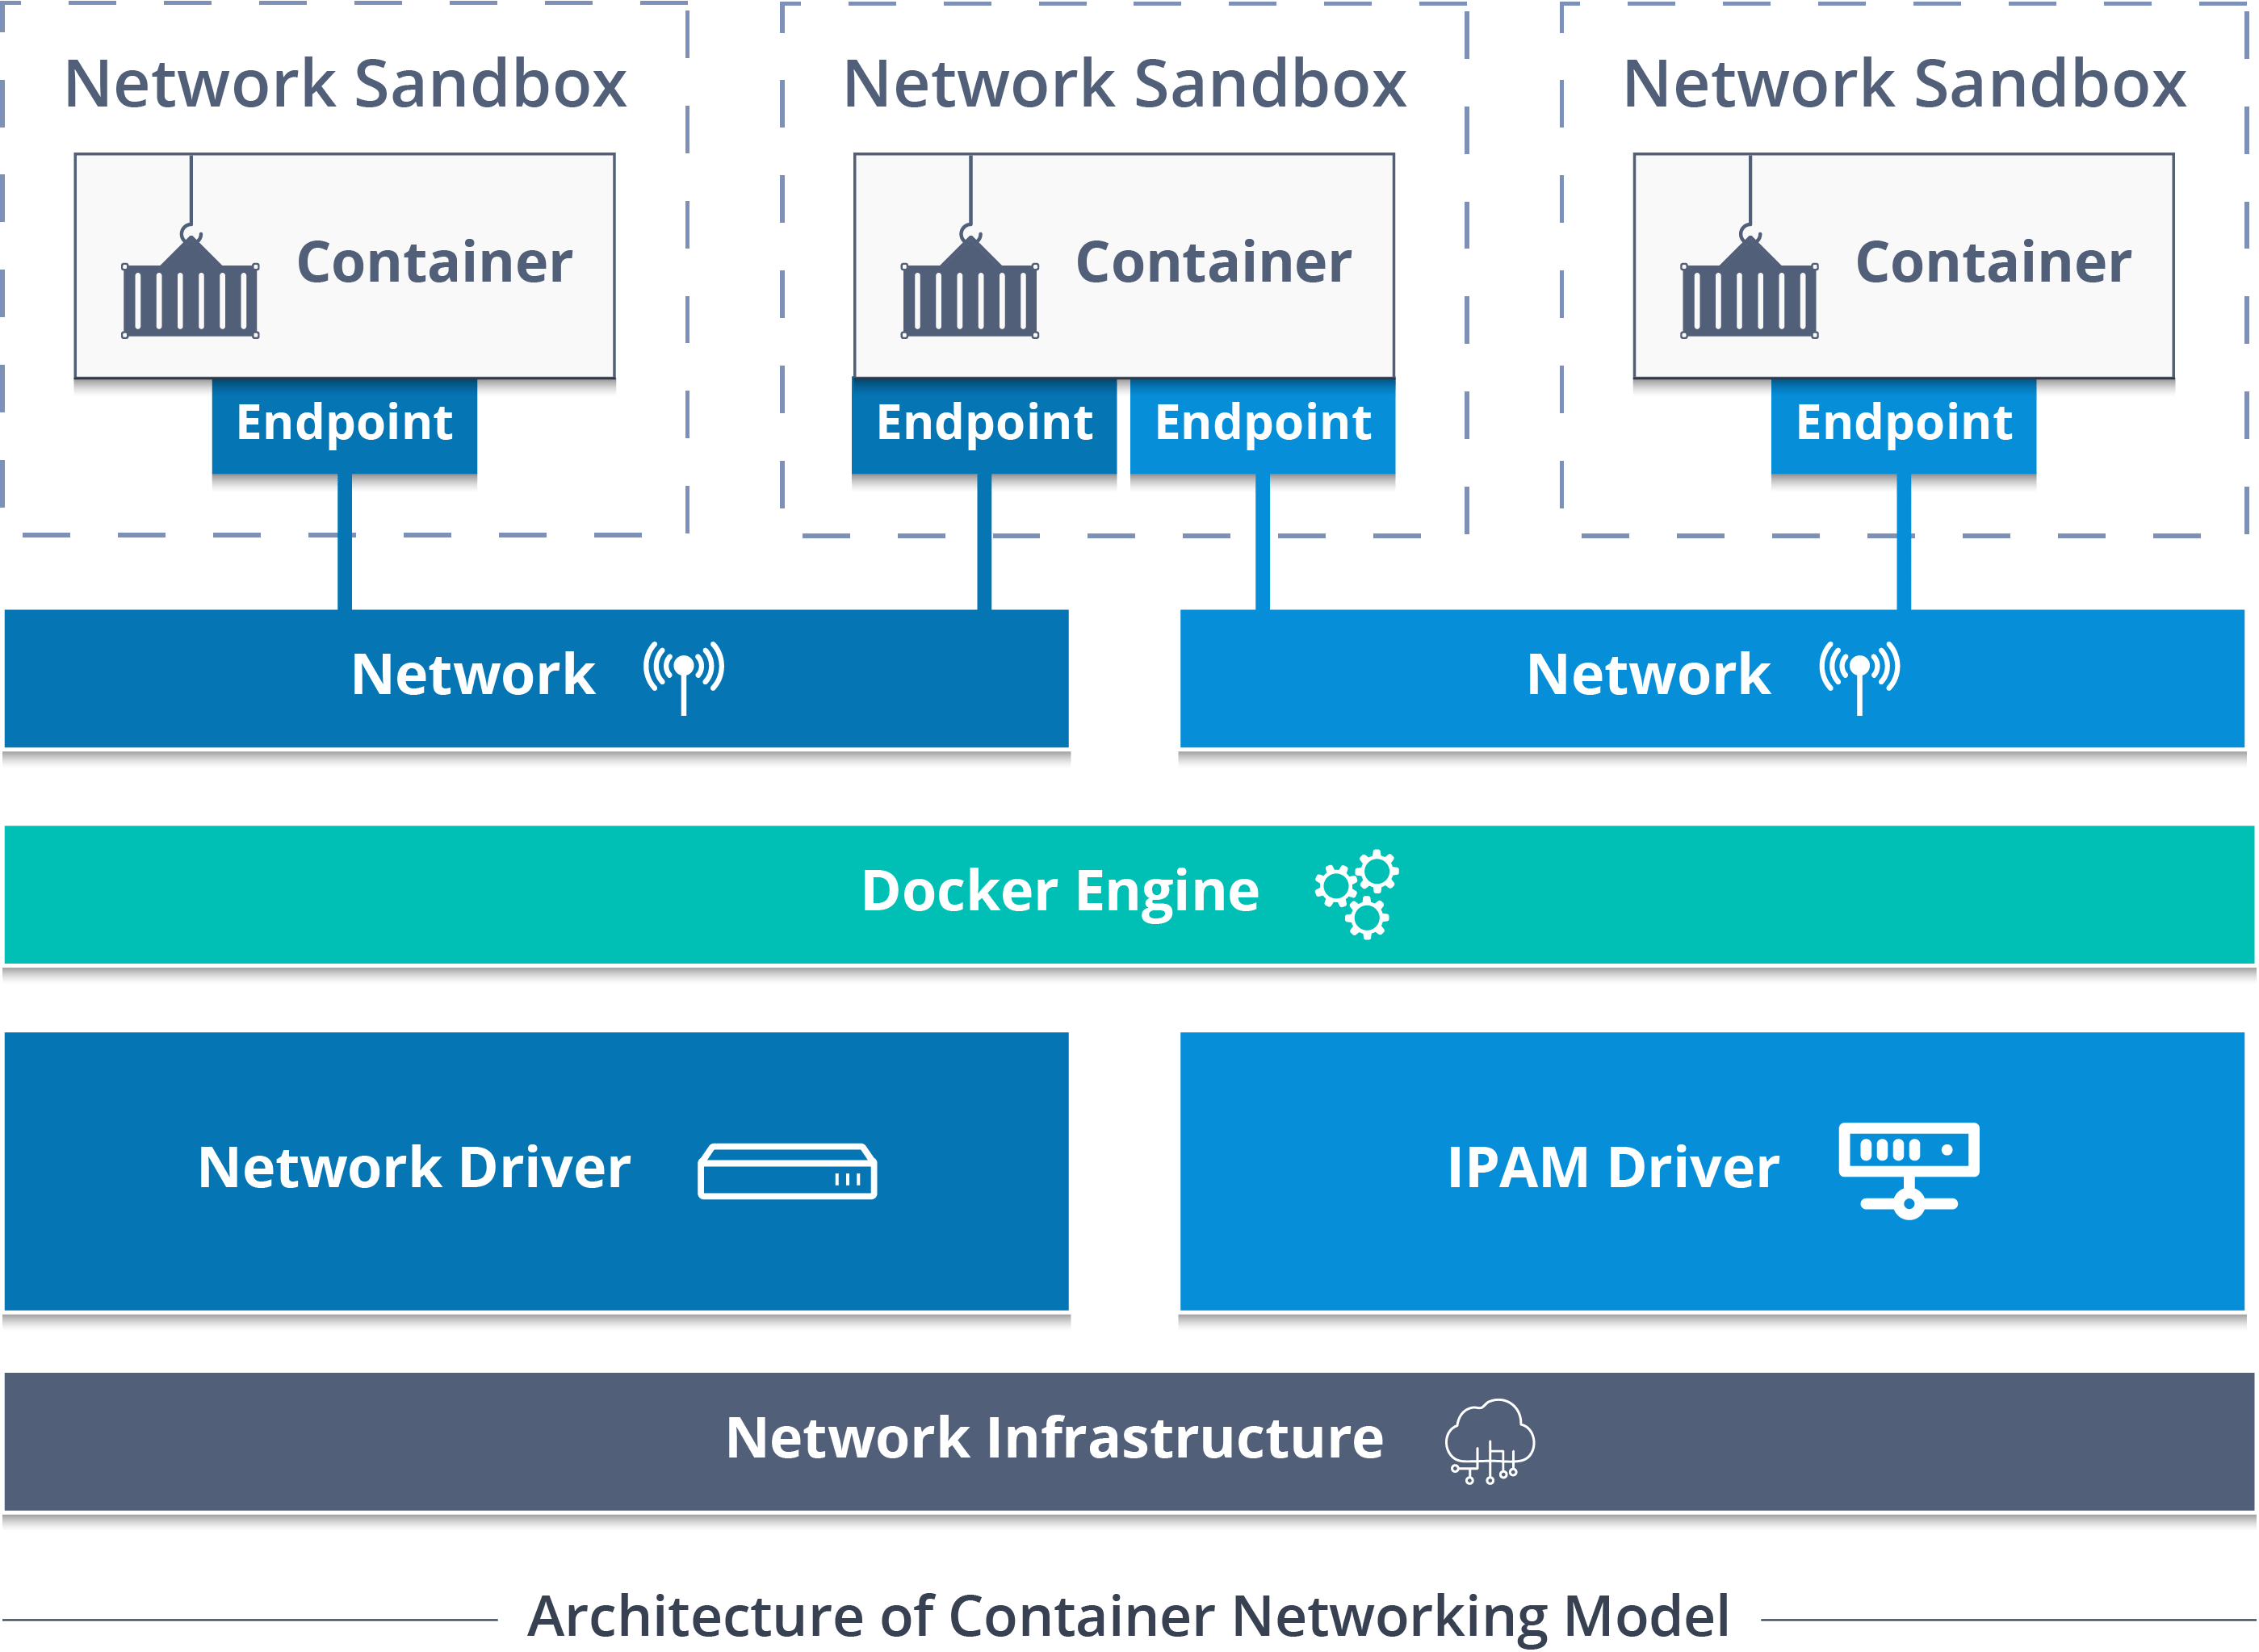

Slide 5
Container Network Model Objects
Network Controller: Provides the entry-point into Libnetwork that exposes simple APIs for Docker Engine to allocate and manage networks. Since Libnetwork supports multiple inbuilt and remote drivers, Network Controller enables users to attach a particular driver to a given network.
Driver: Owns the network and is responsible for managing the network by having multiple drivers participating to satisfy various use-cases and deployment scenarios.
Network: Provides connectivity between a group of endpoints that belong to the same network and isolate from the rest. So, whenever a network is created or updated, the corresponding Driver will be notified of the event.
Endpoint: Provides the connectivity for services exposed by a container in a network with other services provided by other containers in the network. An endpoint represents a service and not necessarily a particular container, Endpoint has a global scope within a cluster as well.
Sandbox: Created when users request to create an endpoint on a network. A Sandbox can have multiple endpoints attached to different networks representing container’s network configuration such as IP-address, MAC-address, routes, DNS

Slide 6
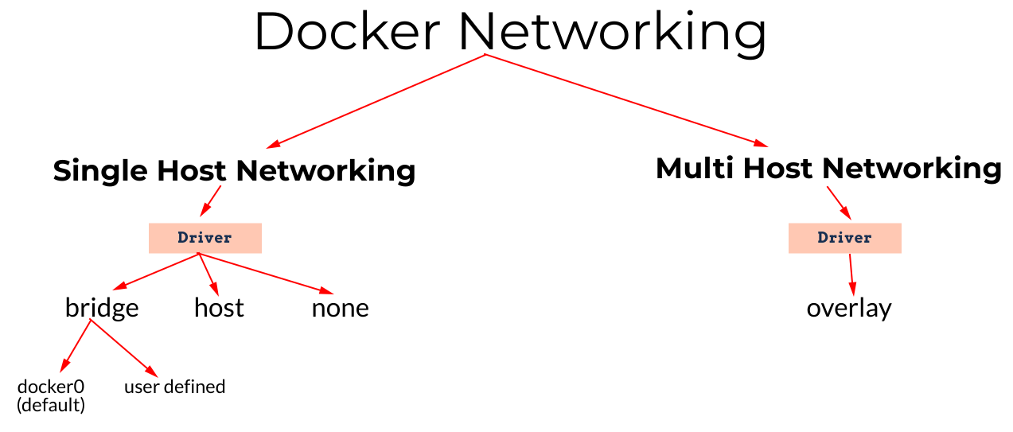
Docker networking allows you to attach a container to as many networks as we like. We can also attach an already running container. Docker offers a mature networking model.

Slide 7
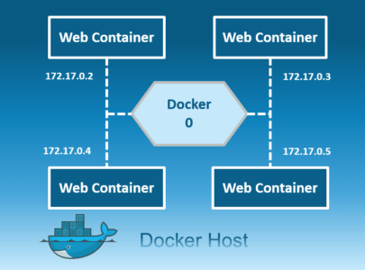
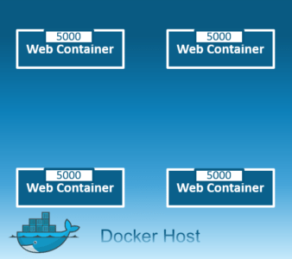
Docker Network’s Types
Bridge Network
Host Network
Host Network
Bridge Network

Slide 8
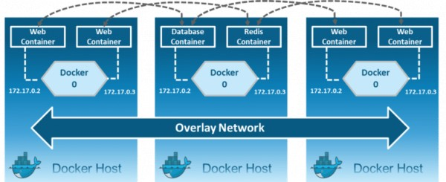
Docker Network’s Types
Overlay Network

Slide 9
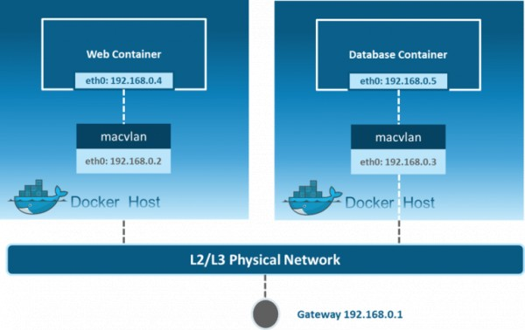
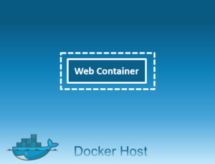
Docker Network’s Types
MacVlan Network
None

Slide 10
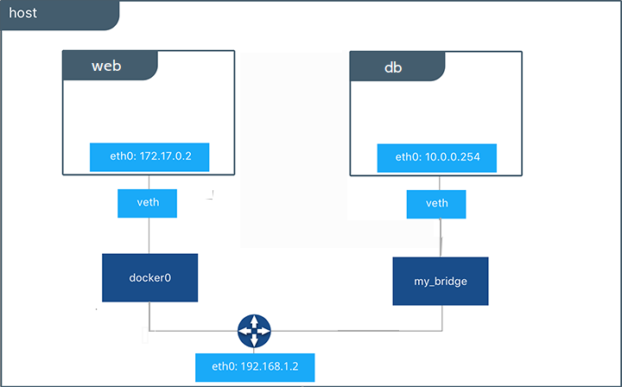
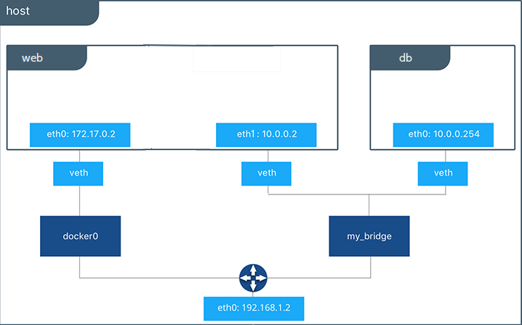
Docker Network Demo
In this demo, we will see Docker bridge with automatic service discovery. And Docker host network.

Slide 11
جزاك اللهُ
To ask questions, please contact
stream@annaafi.org
© Al-Nafi. All Rights Reserved.

